Slide 1

Mirai botnet attack
Submitted by: Nitesh Kumar

Slide 2
Mirai introduction
Mirai botnet was first found in August 2016 by MalwareMustDie a white hat malware research group, and has been used in some of the largest and most disruptive distributed denial of service (DDoS) attacks, including an attack on 20 September 2016 on computer security journalist Brian Krebs's web site, an attack on French web host OVH, and the October 2016 Dyn cyberattack.
The Mirai botnet code infects poorly protected internet devices by using telnet to find those that are still using their factory default username and password. The effectiveness of Mirai is due to its ability to infect tens of thousands of these insecure devices and co-ordinate them to mount a DDOS attack against a chosen victim.

Slide 3
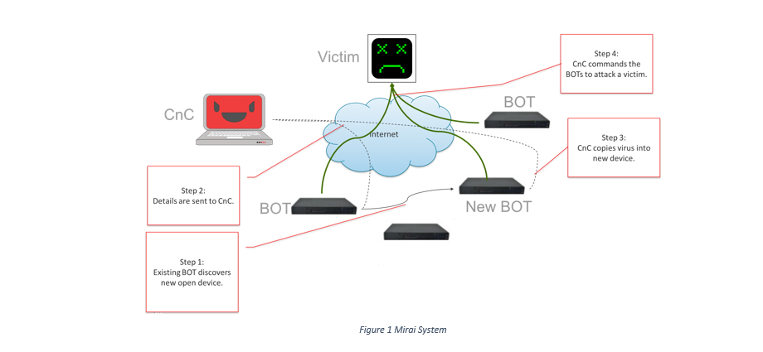
How Mirai Works
The CnC supports a simple command line interface that allows the attacker to specify an attack vector, a victim(s) IP address and an attack duration. The CnC also waits for its existing BOTs to return newly discovered device addresses and credentials which it uses to copy over the virus code and in turn create new BOTs.

Slide 4
Recent Attack with use of mirai malware:
20 September 2016 on computer security journalist Brian Krebs's web site.
An attack on French web host OVH.
October 2016 Dyn Cyber attack.

Slide 5
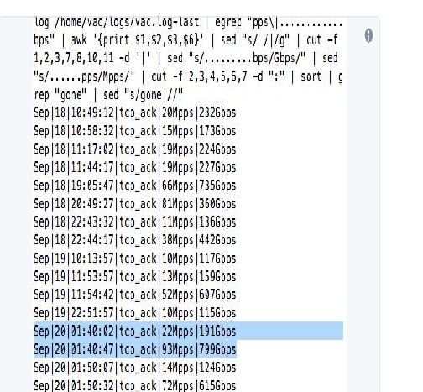
The hosting company OVH was the victim of a 1 Tbsp. DDoS attack that hit its servers,

Slide 6
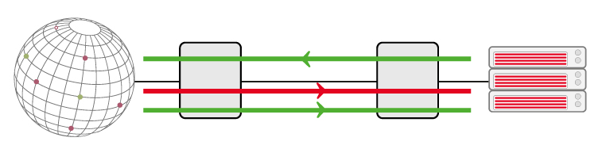
How a DDoS attack operates
The chances of being targeted by a DDoS attack are great and attempts are numerous. A DDoS attack aims to render a server, service or an infrastructure unavailable by overloading the server's bandwidth or monopolizing its resources to the point of depletion. During a DDoS attack, a multitude of requests are sent simultaneously from multiple points across the internet. The intensity of this "crossfire" renders the service unstable, or even worse, unavailable.

Slide 7
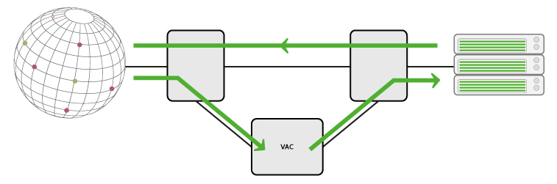
What OVH offer to protect your services
To protect your servers and services from attacks, OVH offers a mitigation solution based on VAC technology - an exclusive combination of techniques to:
Analyzing all packets at high speed in real time
Vacuum your server's incoming traffic
Mitigate i.e. singling out all the illegitimate IP packets, while allowing legitimate ones to pass through.

Slide 8
References:
www.ovh.com
https://heimdalsecurity.com/blog/internet-of-things-security/
https://www.corero.com/resources/ddos-attack-types/mirai-botnet-ddos-attack.html
https://en.wikipedia.org/wiki/Mirai_(malware)

